Slide 1


AUTOHUB
CAR CARE
Your Partner On The Road

Slide 2


What is autohub car care (acc)?
ACC is a comprehensive online platform that integrates the sale of accessories and vehicles, Chapa payment integration, a blog post section for vehicle-related tips and tricks, as well as a job posting feature for drivers seeking employment opportunities, a listing of service providers with chat functionality, and detailed service provider information for efficient vehicle-related transactions and services.

Slide 3

1
Selling Accessories and Vehicles
Contents
2
Chapa Payment Integration
3
Blog Post and Driver Hiring
4
Vehicle Service Providers and Chating
5
System Administration
7
Implementation Technologies
8
Future Enhancements

Slide 4

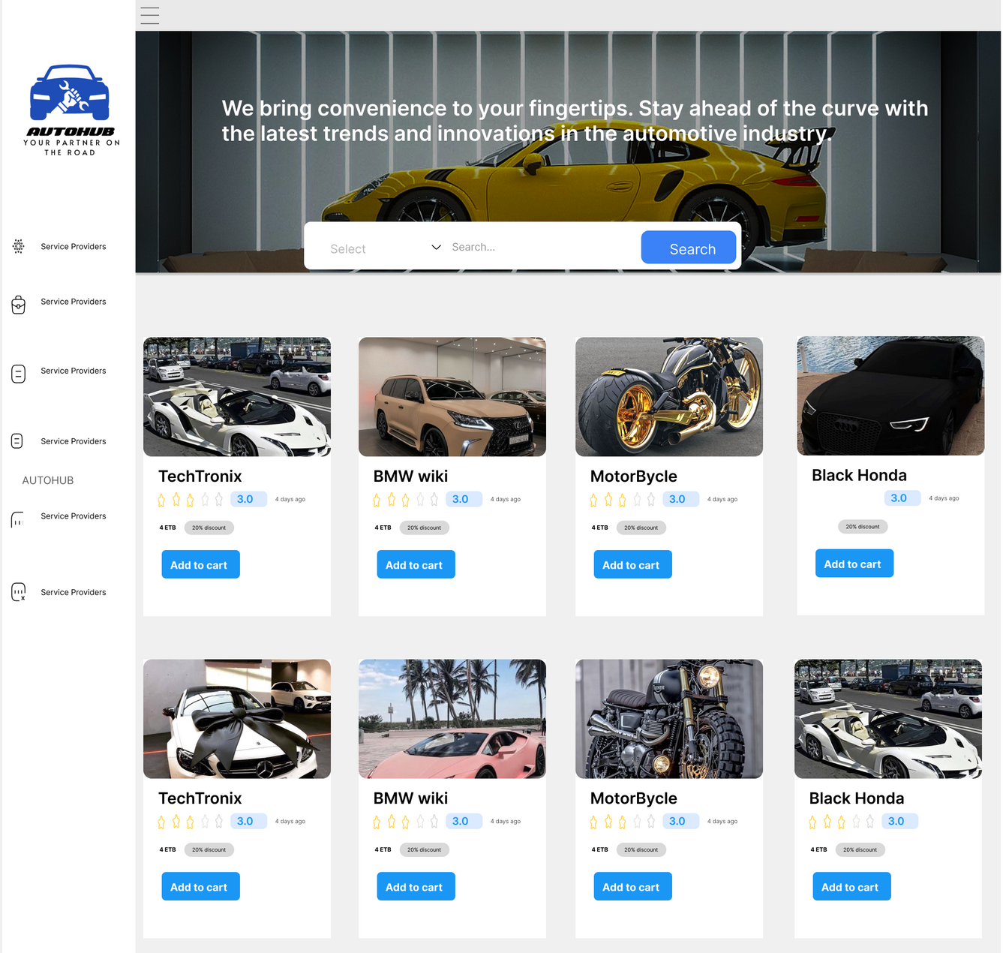
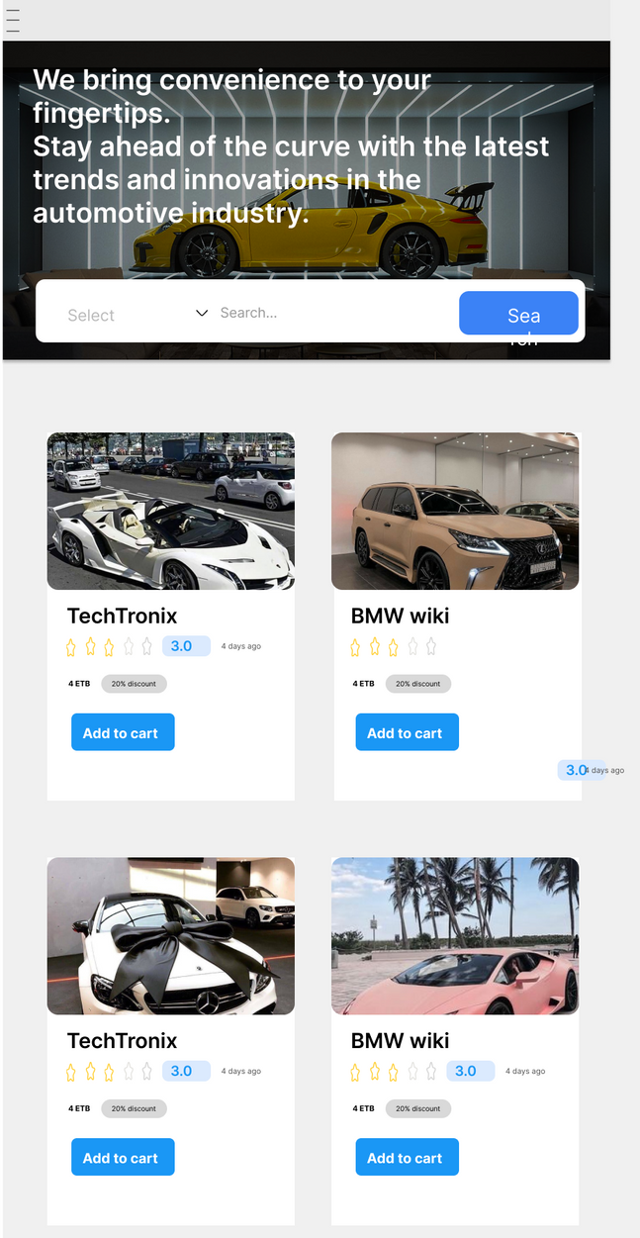

Slide 5

Accessories and Vehicles
Browse Accesso..
Search
Add To Cart
Make Order
Chapa-Payments

Slide 6

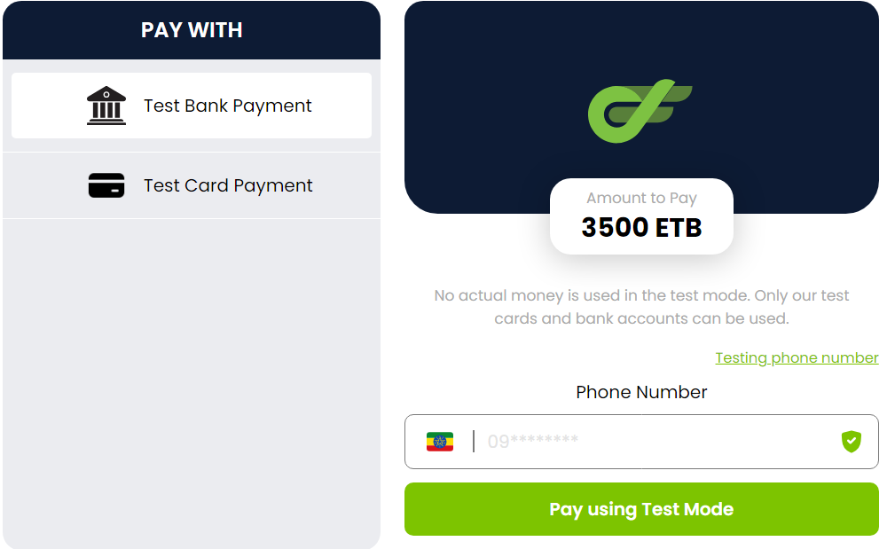

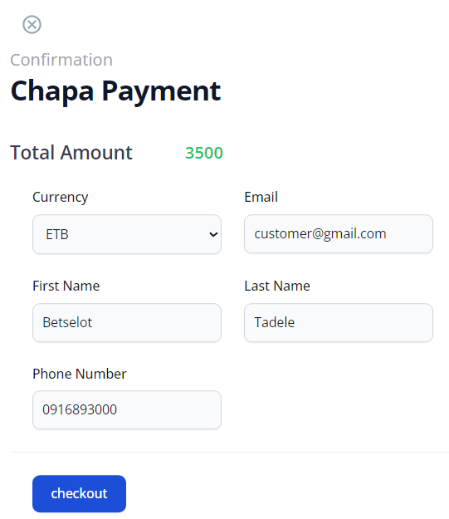

Slide 7


Blog Post and Driver Hiring
Browse blogs..
Browse job..
Search
Search
Comment
Apply
Learn tips & tricks
Become caraficionados

Slide 8


Slide 9
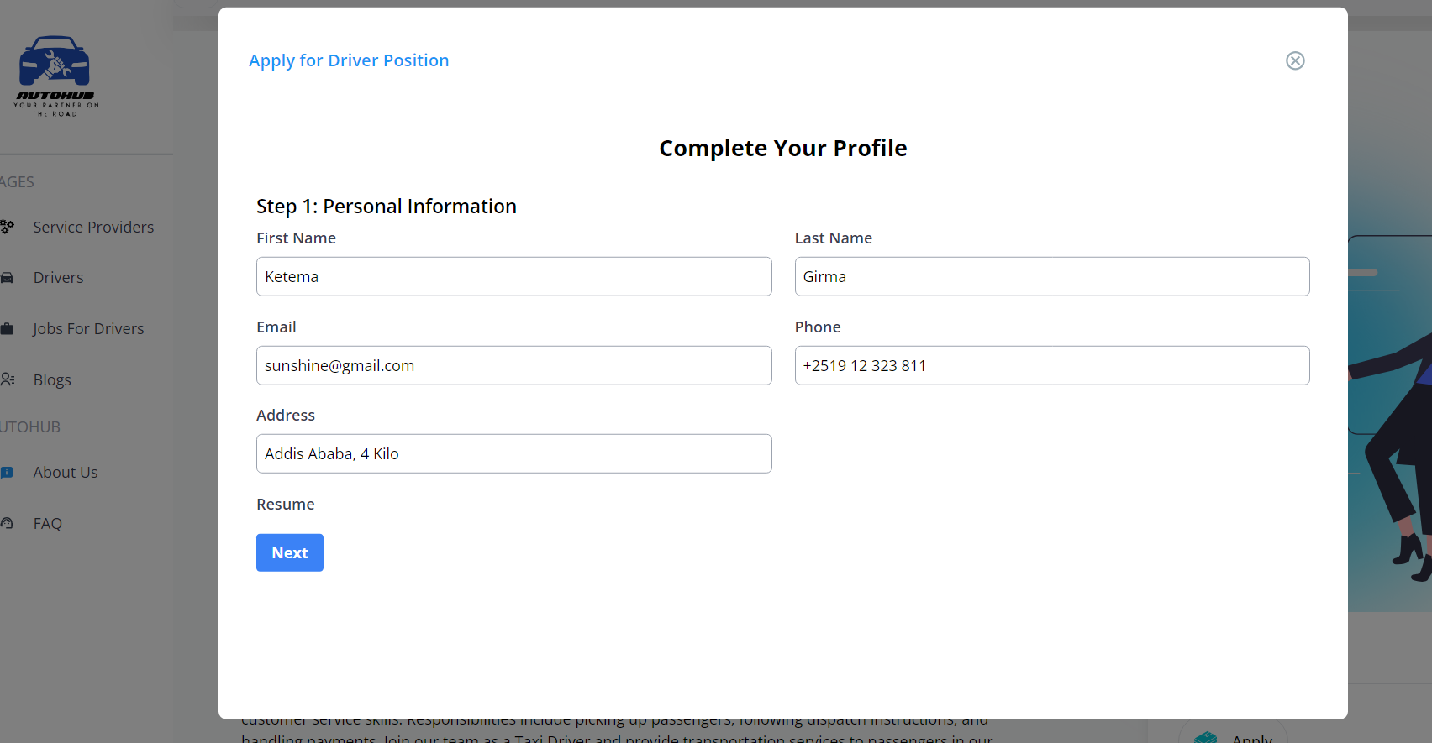

Slide 10
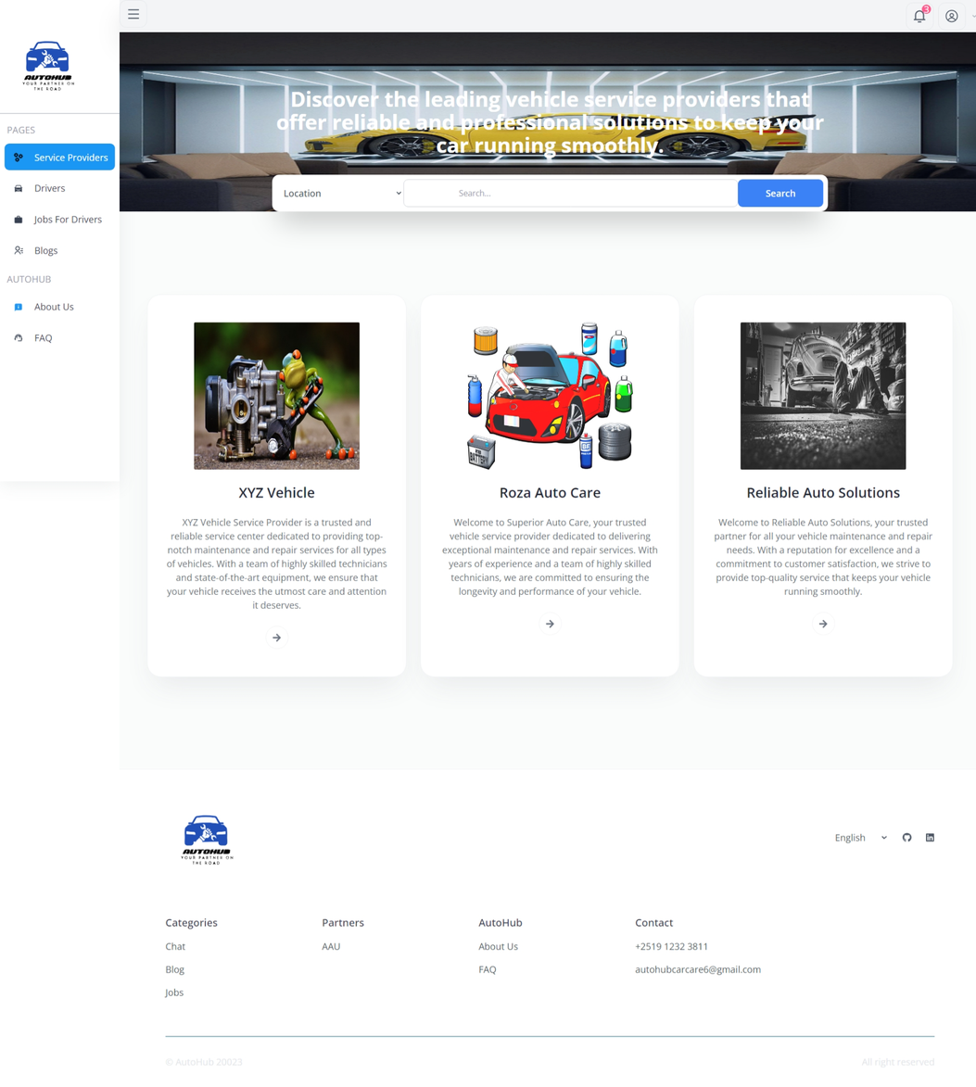


Slide 11
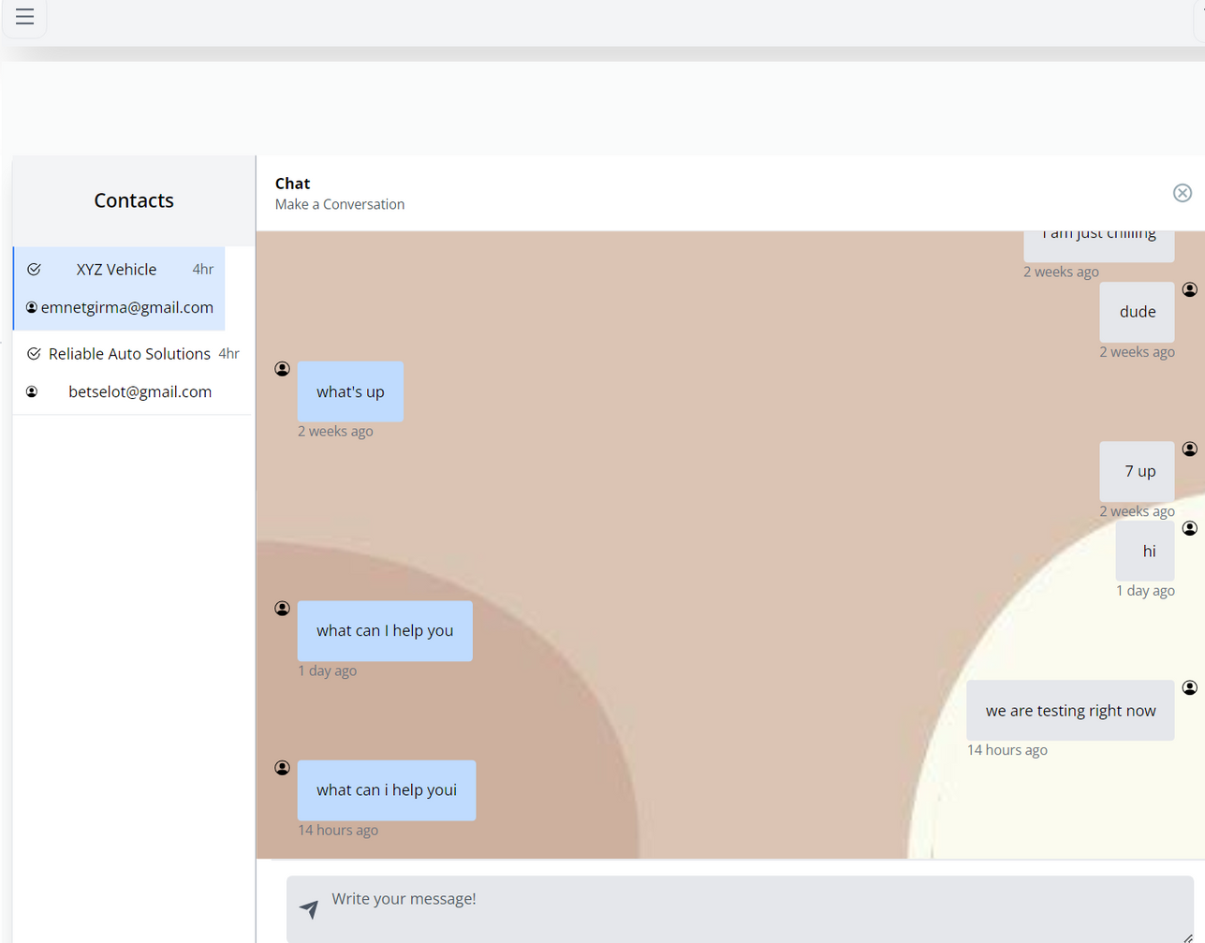
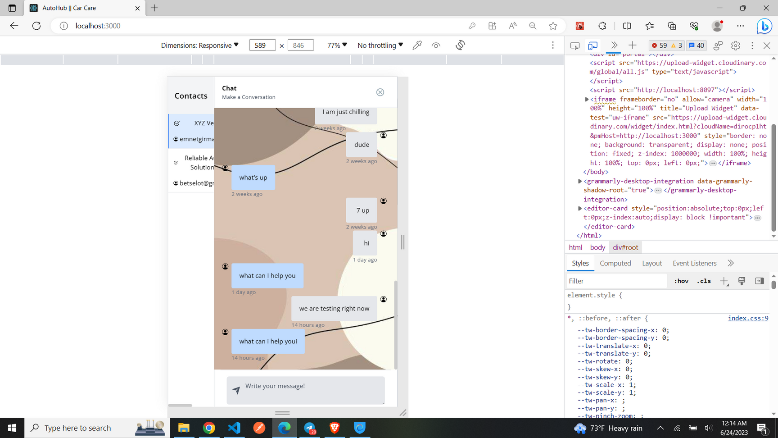

Slide 12

System admin
The system admin in the Autohub Care Car project plays a crucial role in managing user accounts, ensuring their seamless integration with the system, and maintaining the overall efficiency and functionality of the platform.

Slide 13
system admin
Supplier
Drivers
Service Provider..
Caraficionados
Write your ideas to use this tool in EFL.
Write your ideas to use this tool in EFL.
Write your ideas to use this tool in EFL.
Write your ideas to use this tool in EFL.
Job
Notification
Customer
Order
Write your ideas to use this tool in EFL.
Write your ideas to use this tool in EFL.
Write your ideas to use this tool in EFL.
Write your ideas to use this tool in EFL.

Slide 14
potential future enhancements and features for the Autohub Care Car system
Enhanced Mobile Application
Advanced Recommendation System
Enhanced Payment System
Advanced Chatting Feature
Seamless mobile experience with push notifications and location-based services.
Personalized suggestions based on user preferences and history.
Real transactions and expanded payment options for convenience.
Real-time communication and interactive experience between users and service providers.

Slide 15

THANK YOU FOR LISTENING!

